Slide 1
Driving Customer Engagement and Revenue Growth: Insights and Strategies
Imperial Brands
Swathi Annaiah

Slide 2
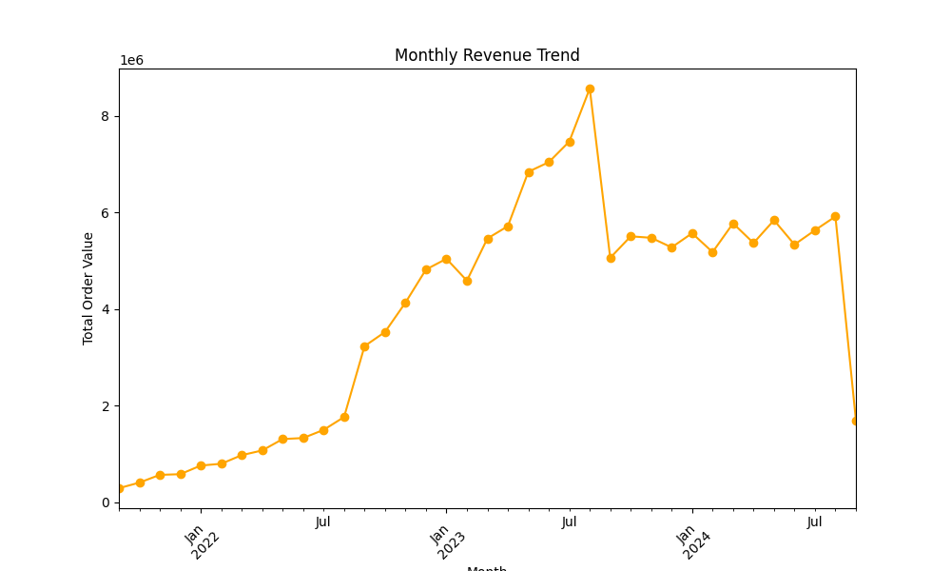
Monthly Revenue Growth and Recent Trends
Growth Period:
Strong revenue growth observed from January 2022 to mid-2023, reaching a peak around mid-2023.

Slide 3
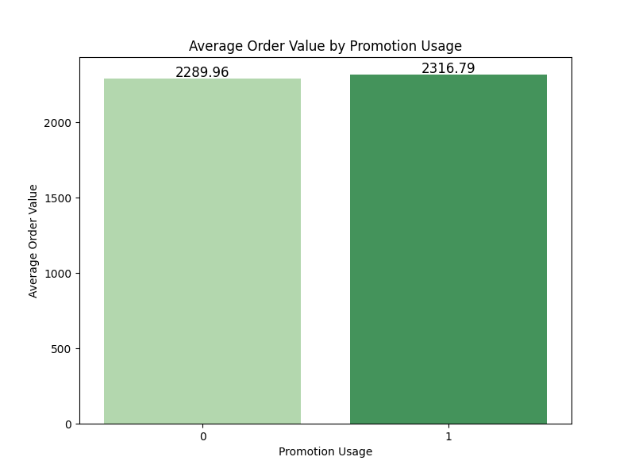
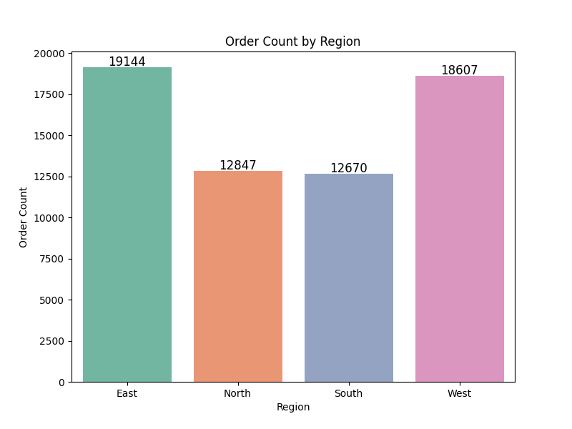
Promotion Impact and Regional Sales Trends
Optimize Promotions:
Promotions have a positive but limited impact on average order value, indicating their role in boosting immediate purchases. Focus on targeted promotions for low-frequency buyers to maximize spending without heavily discounting frequent buyers.
Regional Strategy:
Develop region-specific marketing strategies for North and South, leveraging insights from East and West successes.

Slide 4
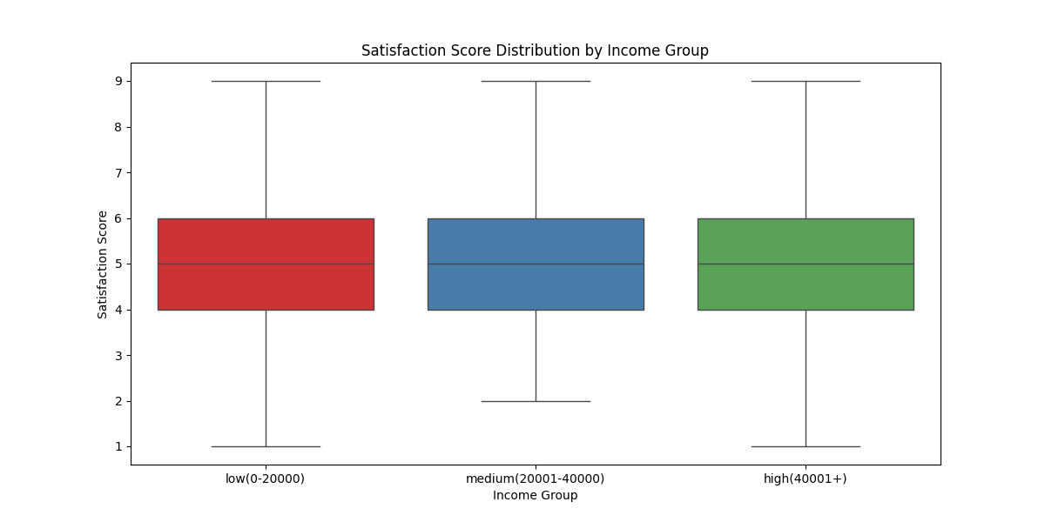
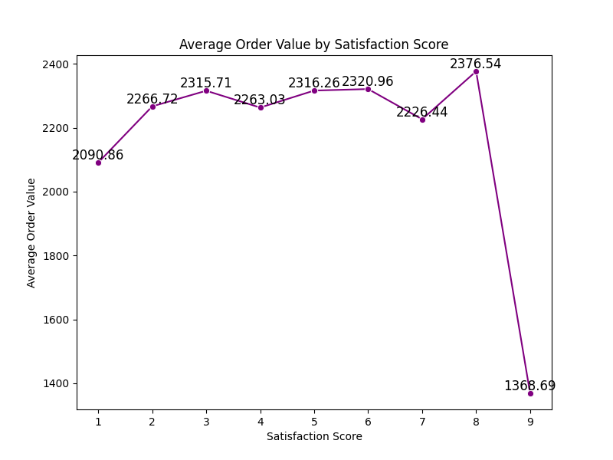
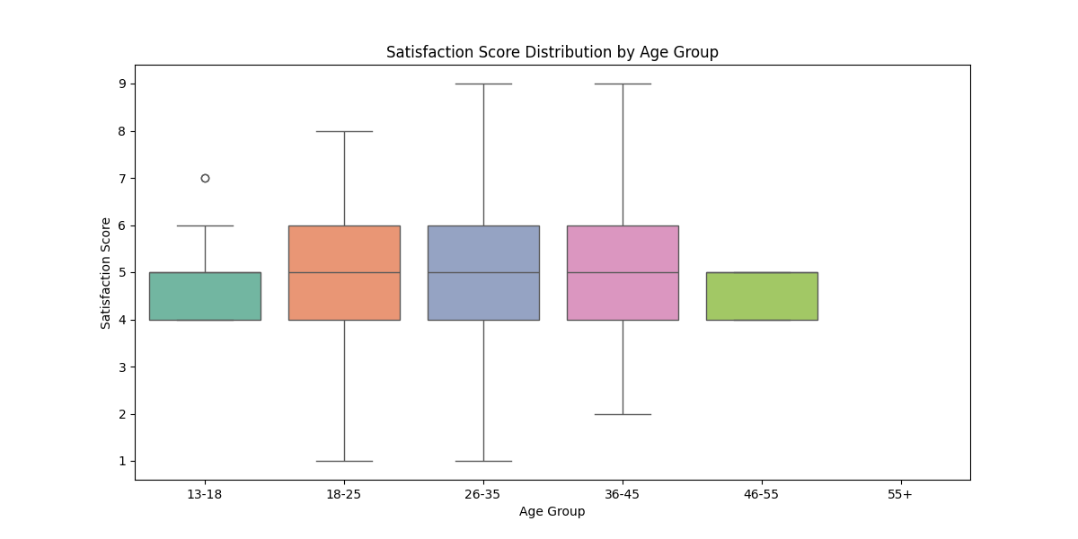
Satisfaction Score Analysis Across Demographics
Address dissatisfaction at satisfaction score 9 by identifying gaps post-high scoring (8).
Develop strategies to improve satisfaction for younger (13-18) and older (46-55) demographics.
Focus on personalized efforts for low-income customers, as their satisfaction variability suggests areas for improvement.

Slide 5
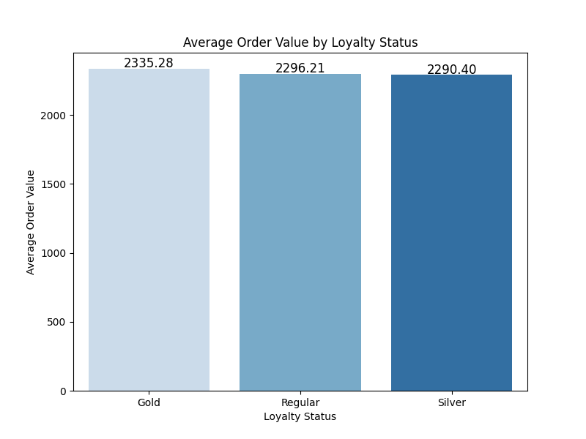
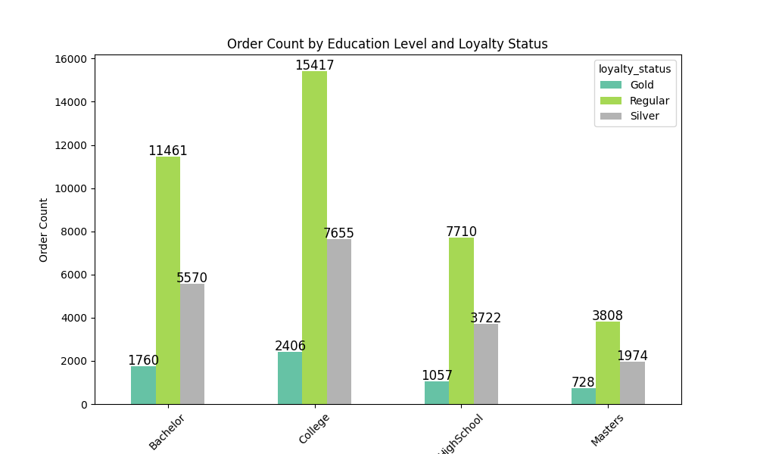
Order Value and Loyalty Trends by Education Level
Gold Members have the highest average order value (2335.28), followed closely by Silver (2290.40) and Regular (2296.21) customers. Minimal variation suggests consistent spending patterns across loyalty tiers.
College and Bachelor's Degree Holders dominate across all loyalty tiers, particularly among Regular customers.
Gold Members have the least representation across education levels, indicating potential under-engagement with higher-value loyalty customers.

Slide 6
Boost Gold Member engagement with exclusive perks.
Target College & Bachelor segments with tailored campaigns.
Leverage consistent spending for upselling opportunities.
Expand outreach to underrepresented education levels (Master's & High School).
Focus on Gold Member retention to sustain high order values.

Slide 7
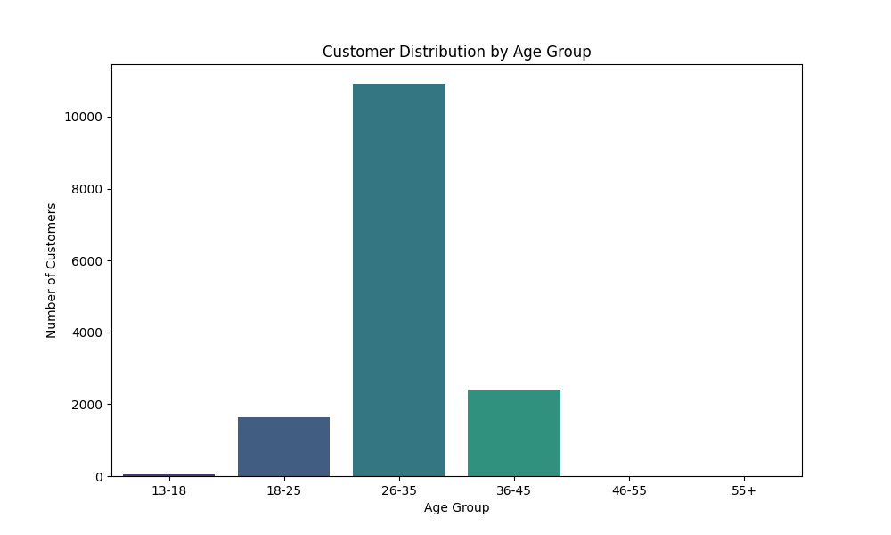
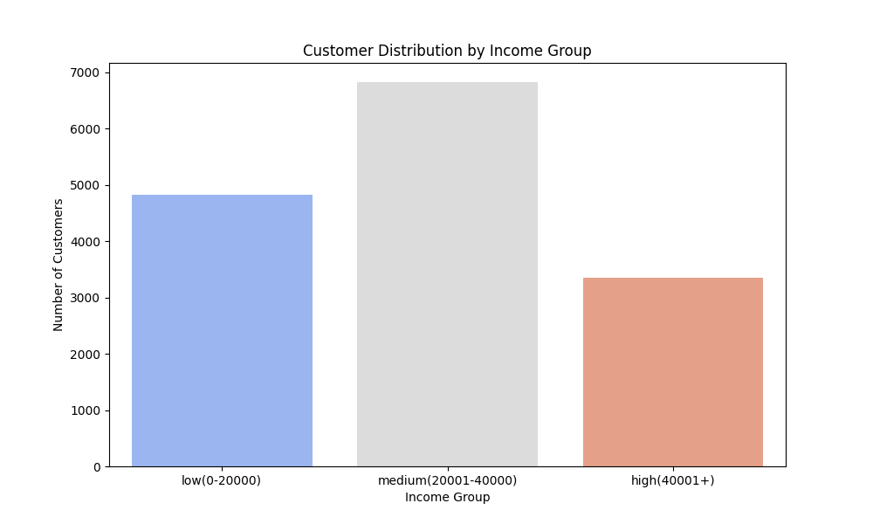
Customer Demographics Analysis: Age & Income Insights
Age Group: Majority are aged 26-35, with minimal engagement from 13-18 and 55+.
Income Group: Most customers are in the 20,001-40,000 range, with limited appeal to 40,001+.
Opportunities: Target younger, older, and high-income segments to expand reach.

Slide 8
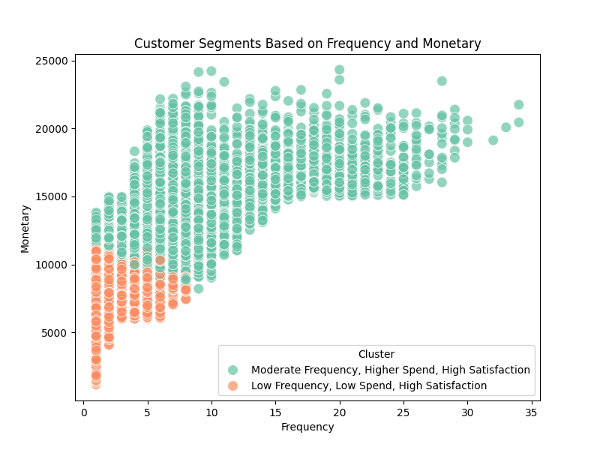
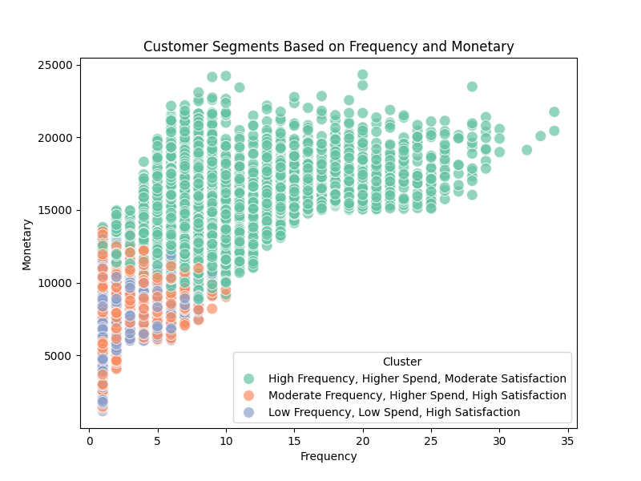
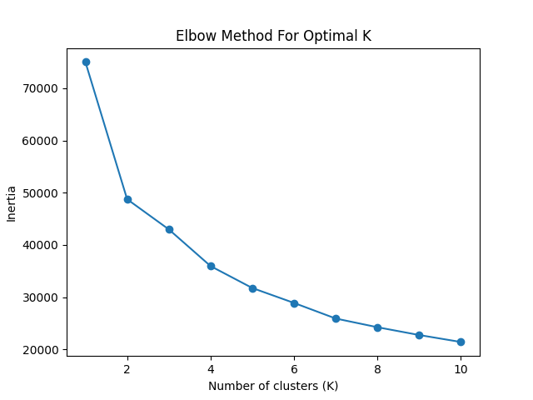
Customer Segmentation & Cluster Analysis
Engage High Frequency, Moderate Satisfaction Customers (Green):
Focus on personalized retention strategies to boost their satisfaction.
Nurture Low Frequency, High Satisfaction Customers (Blue):
Incentivize frequent purchases through loyalty rewards or targeted offers.
Strengthen Moderate Frequency, High Satisfaction Segment (Orange):
Leverage their loyalty to drive referrals and upselling.

Slide 9
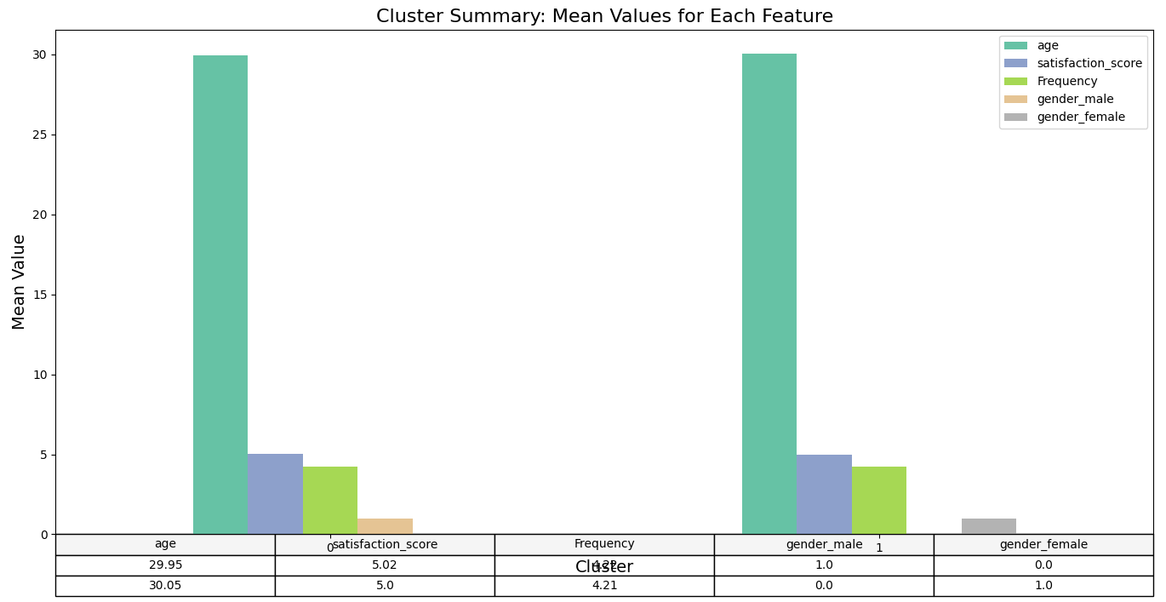
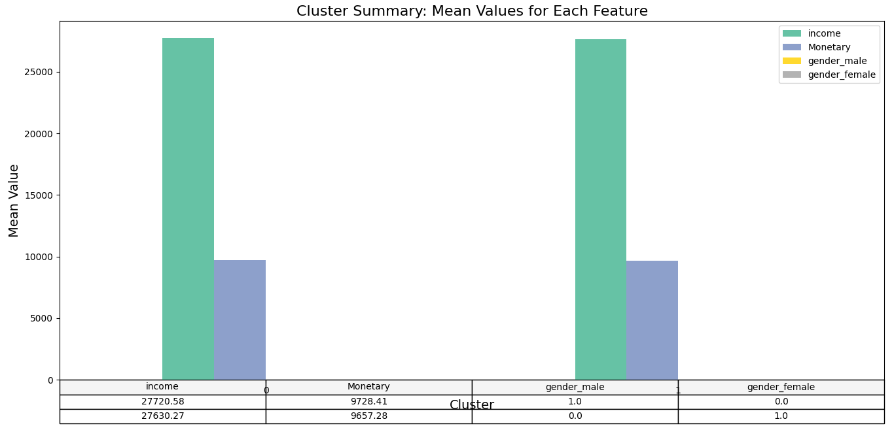
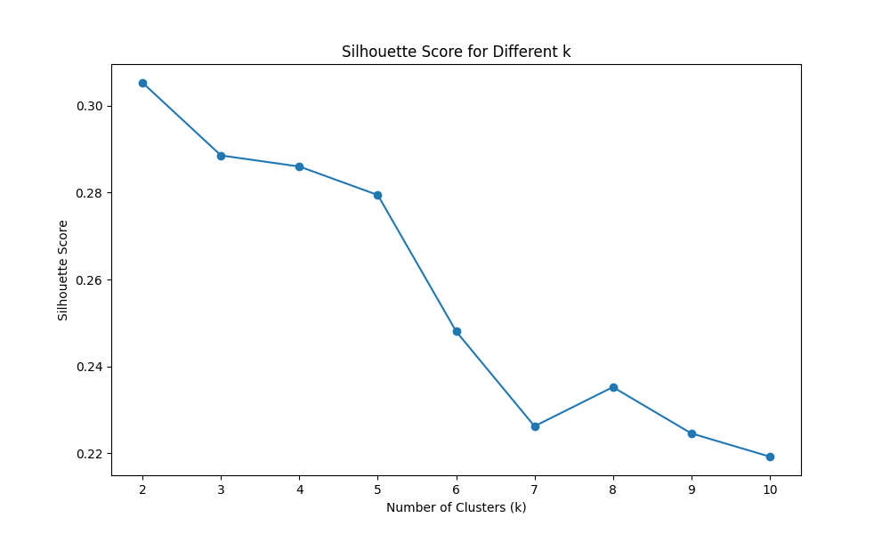
Clustering Insights: Demographics, Income, and Spending Patterns
Focus on Gender-Specific Engagement:
Tailor offers and marketing strategies to align with gender-dominant clusters.
Leverage Income Data:
Upsell to higher-income customers by identifying their preferences and patterns.
Optimize Cluster Count:
Retain k=2 for simplicity and clarity in customer segmentation.

Slide 10
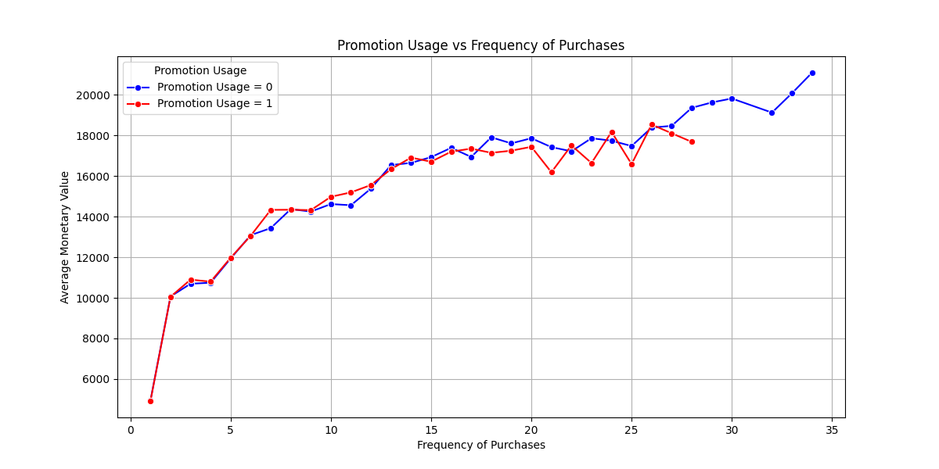
Loyalty and Promotion Impact on Spending
Effectiveness of Promotions:
Promotional users (red line) start with lower initial spend, but their spending quickly aligns with non-promotional users as frequency increases.
Beyond ~10 purchases, both groups spend at similar levels, indicating diminishing impact of promotions for repeat buyers.
Strategic Promotion Targeting:
Focus promotions on infrequent buyers to drive engagement and spending growth.
Limit promotions for frequent buyers, as they show no significant spending improvement.

Slide 11
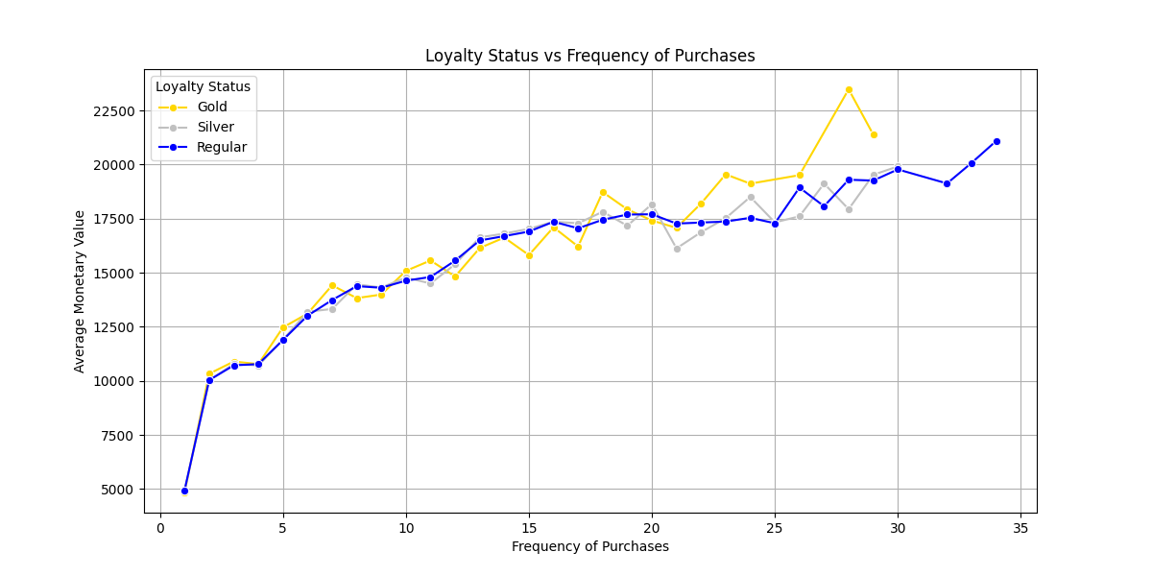
Loyalty and Promotion Impact on Spending
Spending Trends Across Loyalty Tiers:
Gold members consistently show the highest average monetary value as purchase frequency increases.
Silver and Regular members demonstrate similar spending patterns, but Regular members slightly outperform Silver as frequency rises.
Engagement Opportunity:
Encourage Regular and Silver members to increase frequency through loyalty incentives to approach Gold spending levels.

Slide 12
Take Aways
Target Diverse Age Groups:
Engage younger (13-18) and older (55+) demographics with personalized offers.
Enhance Loyalty Programs:
Incentivize Regular and Silver members to upgrade to Gold with exclusive rewards.
Expand Regional Focus:
Boost sales in North and South regions with targeted promotions and partnerships.
Optimize Promotions:
Focus on infrequent buyers for promotions and incentivize loyalty with exclusive deals.
Boost Engagement and Satisfaction:
Upsell to satisfied but low-spending customers and address pain points for high-frequency customers for moderate satisfaction scoring.
Address Seasonal Revenue Plateau:
Develop seasonal campaigns and launch new products to spark growth.
Leverage Clustering Insights:
Personalize engagement based on customer clusters for maximum impact.

